Slide 1
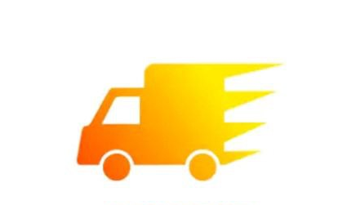
LOADER
WE CARRY YOUR LOAD
BY –
ROHIT KUMAR(0128CS181054)
ASHISH MISHRA(0128CS181012)
AVINASH YADAV KUMAR(0128CS181014)
RAVI SHANKAR KUMAR(0128CS181049)

Slide 2
DESCRIPTION
Loader is a logistics aggregator startup application that makes intra-city pickups and deliveries thoroughly efficient and reliable. Logistics market in India is hugely underserved but has immense potential to come out as one of the largest industry of the world with the interplay of infrastructure and technology, and with Loader we aim to help customers reduce their costs in logistics sector and provide effective services.

Slide 3
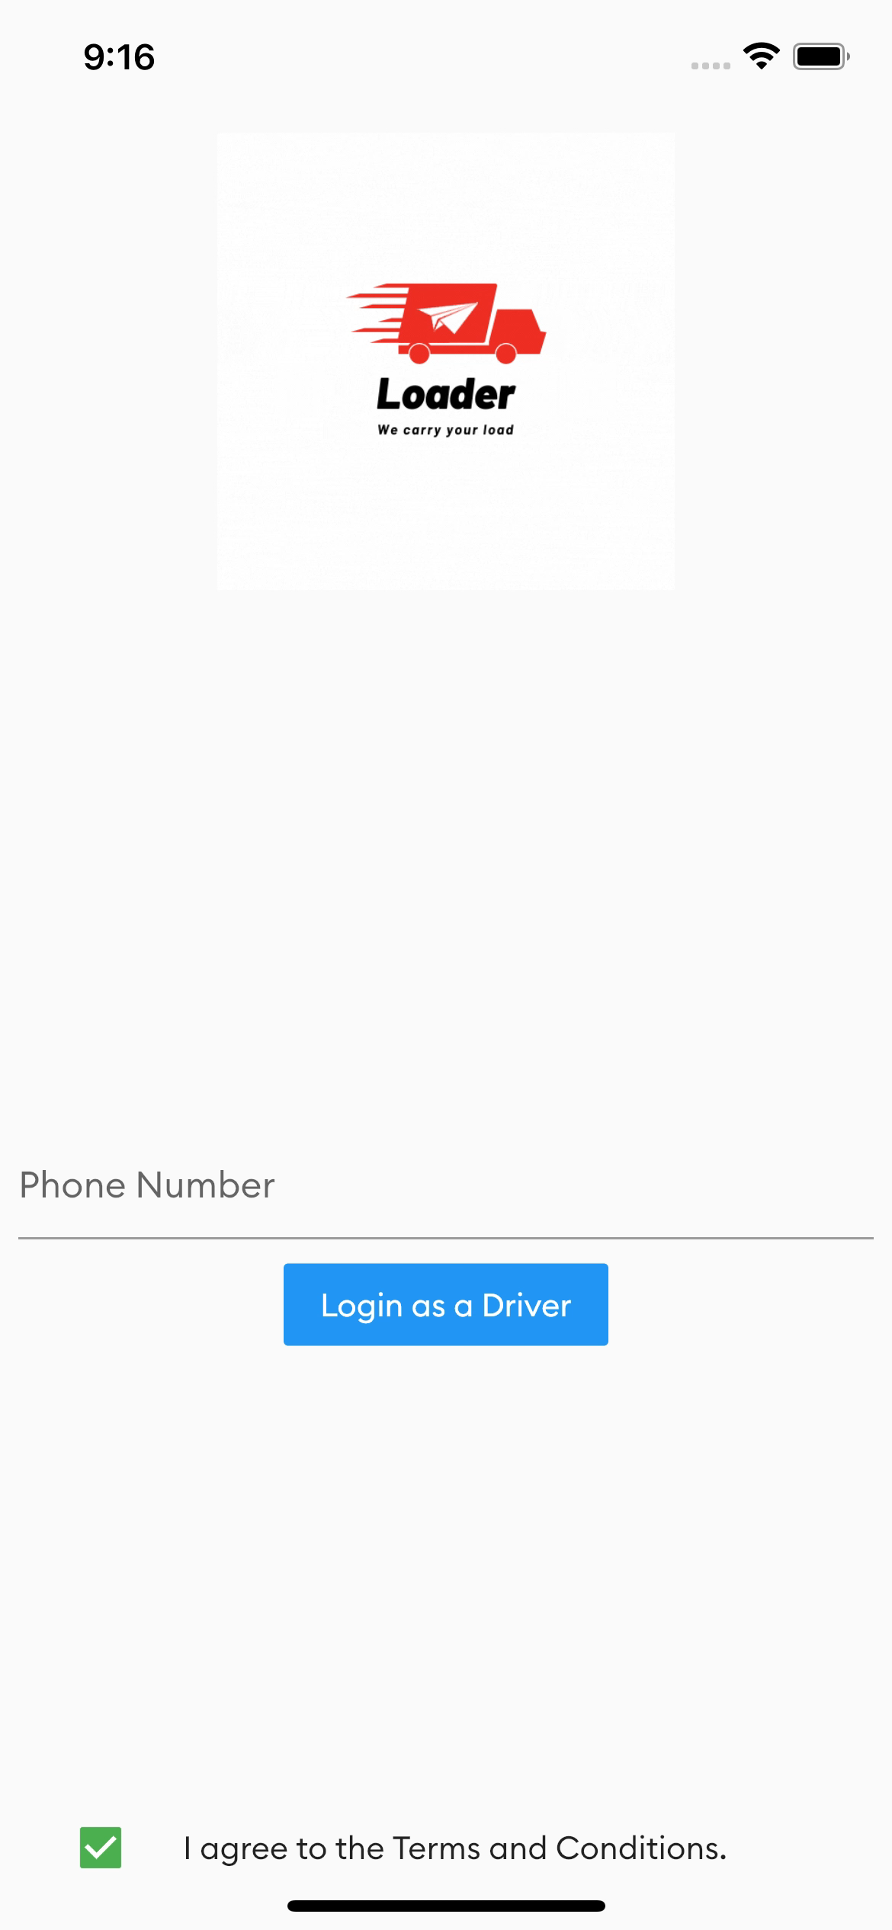
Log in Page

Slide 4
WHY LOADER?
Recently, while I was planning to shift from Indore to Bhopal, I came across some apps. And to my absolute delight, I found that the rates are quite expensive and it was not a good experience when it compared to other local movers and packers.
Though the mobile applications definitely match the standards of decent user experience but there are still a lot of scope to improve and make the application a little more intuitive.

Slide 5
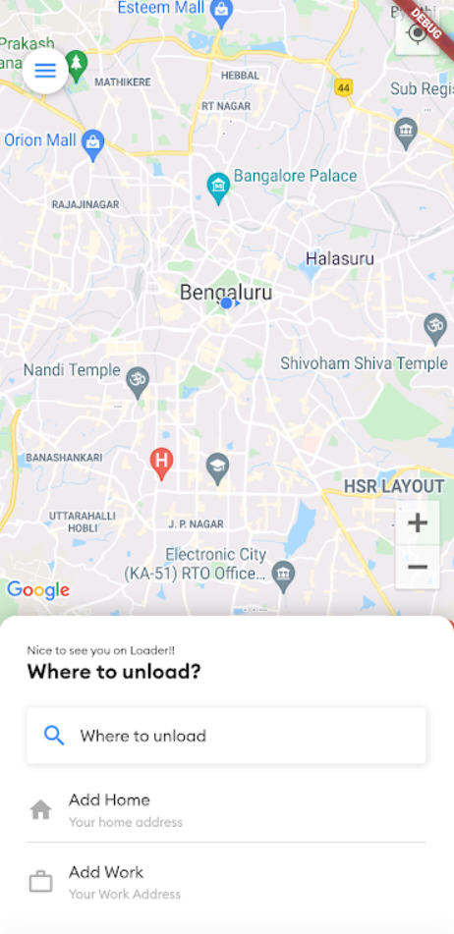
What did I do?
I thought of doing some modifications in the interface design, which probably could be helpful.
The current home page of the app looks something like this :-

Slide 6
Much like an Uber or OlaCabs interface, where the location of the user is already pre-populated in the location bar on top and the different range of cargo trucks can be viewed on swiping right to left and vice versa.
But I see that all the cargos looks same irrespective of being different in a selection slider. And where are the other details? Like minimum price, rates with respect to the distance or rates with respect to the time? And as an user how do I know which truck is cheaper and which one suits my needs to the best?

Slide 7
A decent way to display all the required information but how do I get there? Its pretty simple. Just tap on the circle of the particular cargo and it displays all the required the details.
But there are different personas who use this app and it can be anyone, be it a tech savvy millennial like me, or someone who is not as tech savvy as me, like an uncle who is about 50 years and works in the Indian Army and happens to shift from one city to another owing to his nature of transferrable job.
While it took me around 5 seconds to figure out that on tapping, it would display the details, it might take him much more time, he might also get stuck there and eventually leave the app.

Slide 8
I came up with a screen, though quite similar to the existing design but has a little modifications :-
Sometimes in order to get more quickly from point A to point B, you need to slow down, look up, and see what’s ahead of you. But just as Uber did, rather than taking up the current location or pre filling it, asking the user “Where to?” saves a lot of time and everything starts there and builds around that. Thanks to GPS on our mobile phones, we can fetch the current location.
The second thing that I modified is the selection slider, rather than just truck icons embedded inside a circle, I have used sliding cards.
Why? Because I want the user to see as much relevant information as possible.
The card accommodates information like minimum fare, fare details and most importantly the fare estimates which acts more like a deciding factor.
The user can slider to get from one card to another in order to see the different cargos and their details.

Slide 9
FLUTTER
We use flutter framework for the development ,because it has Dart language support which enables us to use the application to use in Android and IOS both.
Flutter is Google’s free and open-source UI framework for creating native mobile applications. Released in 2017, Flutter allows developers to build mobile applications for both iOS and Android with a single codebase and programming language. This capability makes building iOS and Android apps simpler and faster.
The Flutter framework consists of both a software development kit (SDK) and their widget-based UI library. This library consists of various reusable UI elements, such as sliders, buttons, and text inputs.
Developers building mobile applications with the Flutter framework will do so using a programming language called Dart. With a syntax like JavaScript, Dart is a typed object programming language that focuses on front-end development.

Slide 10
DATABASE
The Firebase Realtime Database is a cloud-hosted database. Data is stored as JSON and synchronized in realtime to every connected client. When you build cross-platform apps with our Apple platforms, Android, and JavaScript SDKs, all of your clients share one Realtime Database instance and automatically receive updates with the newest data.
This is very interesting, we use fire base messaging service for notifications, when one rider wants a cab 🚕 notification is sent to nearest driver , even if app is closed , he will get pop up ,, now when he accepts then the database connection is established

Slide 11
Google Map ApI
Google Maps Platform products are secured from unauthorized use by restricting API calls to those that provide proper authentication credentials. These credentials are in the form of an API key - a unique alphanumeric string that associates your Google billing account with your project, and with the specific API or SDK.
The API key is a unique identifier that authenticates requests associated with your project for usage and billing purposes. You must have at least one API key associated with your project.

Slide 12
We use google APIs to find the distance and ETA to reach the destination from your current location .We have three charges; base charge, distance charge and time charge. These are different for different vehicles and we add these three for ride estimate calculation.
We use Google’s S2 geometry library to calculating shortest ETA.

Slide 13
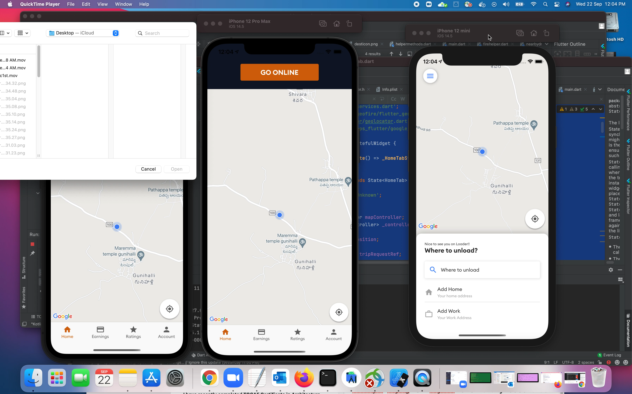

Slide 14
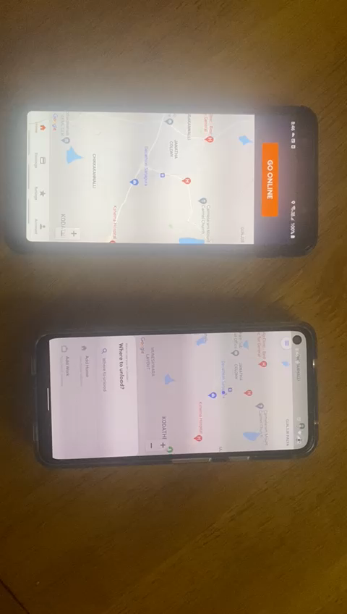
A quick demonstration

